Slide 1
Optical analysis of different glass types
-Ridhesh Goti (19STS030)

Slide 2

Dispersion of light
Light disperse through medium
Wavelength dependency of the refractive index
It depends on the material types/glass type
In general dispersion relation is given by cauchy formula,
Here this relation is depended on only certain range of wavelengths. Within that range it is called as normal dispersion.

Slide 3
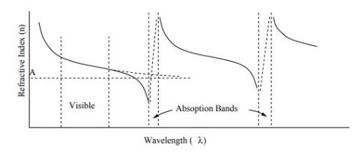

Another type, Anomalous dispersion. At the edge of that region the RI decreases rapidly because of absorption.
In dielectric medium certain range of wavelengths are absorbed. After that there is one peak due to resonance.
Final equation due to electric field effect of light on medium is,

Slide 4

Relation trends :
(1) Refractive index of substance increases with decreasing of wavelength
(2) The rate of increase becomes greater at shorter wavelength.
Abbe number (measurement of dispersion):
Low abbe number means that dispersion is high and vice versa.
Nd, Nf, Nc are refractive index of material at wavelengths of Fraunhofer D,F and C lines(589.3 nm, 486.1 nm, 656.3 nm respectively).
Flint glass has abbe number V < 50 and crown glass has V > 50.

